Slide 1

Inheritance and Polymorphism
SCHOOL OF COMPUTER ENGINEERING AND TECHNOLOGY

Slide 2
Inheritance in Java
Inheritance is an important pillar of OOP(Object-Oriented Programming). It is the mechanism in java by which one class is allowed to inherit the features(fields and methods) of another class.
Important terminology:
Super Class: The class whose features are inherited is known as superclass(or a base class or a parent class).
Sub Class: The class that inherits the other class is known as a subclass(or a derived class, extended class, or child class). The subclass can add its own fields and methods in addition to the superclass fields and methods.
Reusability: Inheritance supports the concept of “reusability”, i.e. when we want to create a new class and there is already a class that includes some of the code that we want, we can derive our new class from the existing class. By doing this, we are reusing the fields and methods of the existing class.

Slide 3
Inheritance in Java
Advantage of inheritance
If we develop any application using concept of Inheritance then that application have following advantages:
Application development time is less.
Application take less memory.
Application performance is enhance (improved).
Redundancy (repetition) of the code is reduced or minimized so that we get consistent results and less storage cost.

Slide 4

Inheritance in Java
Real Life Example of Inheritance in Java
The real life example of inheritance is child and parents, all the properties of father are inherited by his son.

Slide 5
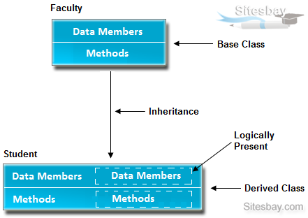
Inheritance in Java
The following diagram provides a view about inheritance:
In the above diagram data members and methods are represented in broken line are inherited from faculty class and they are visible in student class logically.

Slide 6
How to use inheritance in Java
The keyword used for inheritance is extends.
Syntax :
class derived-class extends base-class
{
//methods and fields
}

Slide 7
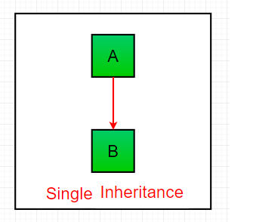
Types of Inheritance in Java
Below are the different types of inheritance which are supported by Java.
1. Single Inheritance: In single inheritance, subclasses inherit the features of one superclass. In the image below, class A serves as a base class for the derived class B.

Slide 8
Example
import java.io.*;
import java.lang.*;
import java.util.*;
class one {
public void print_geek()
{
System.out.println("Geeks");
}
}
class two extends one {
public void print_for() { System.out.println("for"); }
}
// Driver class
public class Demo {
public static void main(String[] args)
{
two g = new two();
g.print_geek();
g.print_for();
g.print_geek();
}
}

Slide 9
Example
import java.io.*;
import java.lang.*;
import java.util.*;
class one {
public void print_geek()
{
System.out.println("Geeks");
}
}
class two extends one {
public void print_for() { System.out.println("for"); }
}
// Driver class
public class Demo {
public static void main(String[] args)
{
two g = new two();
g.print_geek();
g.print_for();
g.print_geek();
}
}
Output
Geeks
for
Geeks

Slide 10
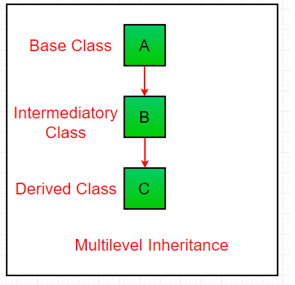
Multilevel Inheritance
In Multilevel Inheritance, a derived class will be inheriting a base class and as well as the derived class also act as the base class to other class.
In the below image, class A serves as a base class for the derived class B, which in turn serves as a base class for the derived class C.

Slide 11
// Java program to illustrate the // concept of Multilevel inheritance
import java.io.*;
import java.lang.*;
import java.util.*;
class one {
public void print_geek()
{
System.out.println("Geeks");
}
}
class two extends one {
public void print_for() { System.out.println("for");
}
}
class three extends two {
public void print_geek3()
{
System.out.println(“geeks");
}
}
// Drived class
public class Demo {
public static void main(String[] args)
{
three g = new three();
g.print_geek();
g.print_for();
g.print_geek3();
}
}

Slide 12
// Java program to illustrate the // concept of Multilevel inheritance
import java.io.*;
import java.lang.*;
import java.util.*;
class one {
public void print_geek()
{
System.out.println("Geeks");
}
}
class two extends one {
public void print_for() { System.out.println("for");
}
}
class three extends two {
public void print_geek3()
{
System.out.println(“geeks");
}
}
// Drived class
public class Demo {
public static void main(String[] args)
{
three g = new three();
g.print_geek();
g.print_for();
g.print_geek3();
}
}
Output
Geeks
for
geeks

Slide 13
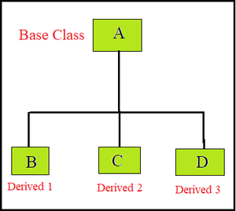
Hierarchical Inheritance
In Hierarchical Inheritance, one class serves as a superclass (base class) for more than one subclass. In the below image, class A serves as a base class for the derived class B, C and D.

Slide 14
Java program to illustrate the concept of Hierarchical inheritance
class A {
public void print_A() { System.out.println("Class A"); }
}
class B extends A {
public void print_B() { System.out.println("Class B"); }
}
class C extends A {
public void print_C() { System.out.println("Class C"); }
}
class D extends A {
public void print_D() { System.out.println("Class D"); }
}
// Driver Class
public class Test {
public static void main(String[] args)
{
B obj_B = new B();
obj_B.print_A();
obj_B.print_B();
C obj_C = new C();
obj_C.print_A();
obj_C.print_C();
D obj_D = new D();
obj_D.print_A();
obj_D.print_D();
}
}

Slide 15
Java program to illustrate the concept of Hierarchical inheritance
class A {
public void print_A() { System.out.println("Class A"); }
}
class B extends A {
public void print_B() { System.out.println("Class B"); }
}
class C extends A {
public void print_C() { System.out.println("Class C"); }
}
class D extends A {
public void print_D() { System.out.println("Class D"); }
}
// Driver Class
public class Test {
public static void main(String[] args)
{
B obj_B = new B();
obj_B.print_A();
obj_B.print_B();
C obj_C = new C();
obj_C.print_A();
obj_C.print_C();
D obj_D = new D();
obj_D.print_A();
obj_D.print_D();
}
}
Output
Class A
Class B
Class A
Class C
Class A
Class D

Slide 16
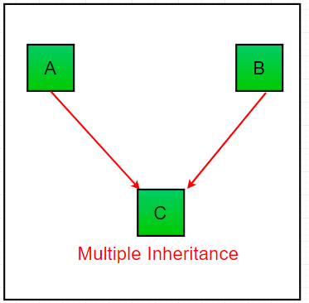
Multiple Inheritance (Through Interfaces)
In Multiple inheritances, one class can have more than one superclass and inherit features from all parent classes.
Please note that Java does not support multiple inheritances with classes.
In java, we can achieve multiple inheritances only through Interfaces. In the image below, Class C is derived from interface A and B.

Slide 17
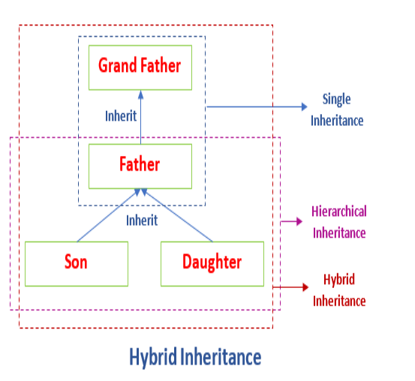
Hybrid Inheritance
It is a mix of two or more of the above types of inheritance.
Since java doesn’t support multiple inheritances with classes, hybrid inheritance is also not possible involving multiple inheritances with classes.

Slide 18
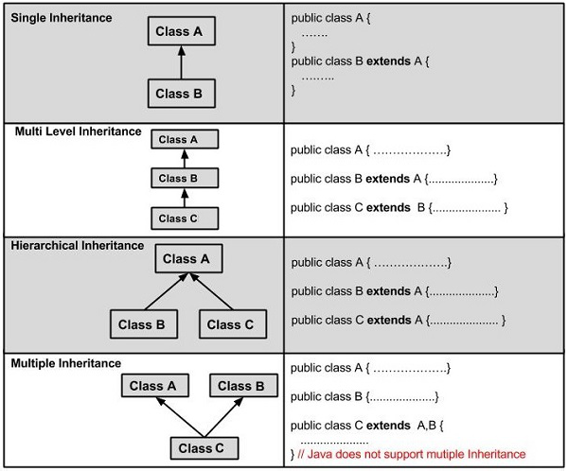

Slide 19
Important facts about inheritance in Java
Default superclass: Except Object class, which has no superclass, every class has one and only one direct superclass (single inheritance). In the absence of any other explicit superclass, every class is implicitly a subclass of the Object class.
Superclass can only be one: A superclass can have any number of subclasses. But a subclass can have only one superclass. This is because Java does not support multiple inheritances with classes. Although with interfaces, multiple inheritances are supported by java.
Inheriting Constructors: A subclass inherits all the members (fields, methods, and nested classes) from its superclass. Constructors are not members, so they are not inherited by subclasses, but the constructor of the superclass can be invoked from the subclass.
Private member inheritance: A subclass does not inherit the private members of its parent class. However, if the superclass has public or protected methods(like getters and setters) for accessing its private fields, these can also be used by the subclass.

Slide 20
What all can be done in a Subclass?
In sub-classes we can inherit members as is, replace them, hide them, or supplement them with new members:
The inherited fields can be used directly, just like any other fields.
We can declare new fields in the subclass that are not in the superclass.
The inherited methods can be used directly as they are.
We can write a new instance method in the subclass that has the same signature as the one in the superclass, thus overriding it
We can write a new static method in the subclass that has the same signature as the one in the superclass, thus hiding it.
We can declare new methods in the subclass that are not in the superclass.
We can write a subclass constructor that invokes the constructor of the superclass, either implicitly or by using the keyword super.

Slide 21
The super keyword
The super keyword is similar to this keyword. Following are the scenarios where the super keyword is used.
It is used to differentiate the members of superclass from the members of subclass, if they have same names.
It is used to invoke the superclass constructor from subclass.
Differentiating the Members
If a class is inheriting the properties of another class. And if the members of the superclass have the names same as the sub class, to differentiate these variables we use super keyword as shown below.
super.variable
super.method();

Slide 22
The super keyword
class Super_class {
int num = 20;
// display method of superclass
public void display() {
System.out.println("This is the display method of superclass");
}
}
public class Sub_class extends Super_class {
int num = 10;
// display method of sub class
public void display() {
System.out.println("This is the display method of subclass");
}
public void my_method() {
// Instantiating subclass
Sub_class sub = new Sub_class();
// Invoking the display() method of sub class
sub.display();
// Invoking the display() method of superclass
super.display();
// printing the value of variable num of subclass
System.out.println("value of the variable named num in sub class:"+ sub.num);
// printing the value of variable num of superclass
System.out.println("value of the variable named num in super class:"+ super.num);
}
public static void main(String args[]) {
Sub_class obj = new Sub_class();
obj.my_method();
}
}

Slide 23
The super keyword
class Super_class {
int num = 20;
// display method of superclass
public void display() {
System.out.println("This is the display method of superclass");
}
}
public class Sub_class extends Super_class {
int num = 10;
// display method of sub class
public void display() {
System.out.println("This is the display method of subclass");
}
public void my_method() {
// Instantiating subclass
Sub_class sub = new Sub_class();
// Invoking the display() method of sub class
sub.display();
// Invoking the display() method of superclass super.display();
// printing the value of variable num of subclass
System.out.println("value of the variable named num in sub class:"+ sub.num);
// printing the value of variable num of superclass
System.out.println("value of the variable named num in super class:"+ super.num);
}
public static void main(String args[]) {
Sub_class obj = new Sub_class();
obj.my_method();
}
}
Output
This is the display method of subclass
This is the display method of superclass
value of the variable named num in sub class:10
value of the variable named num in super class:20

Slide 24
Java IS-A type of Relationship
IS-A is a way of saying: This object is a type of that object. Let us see how the extends keyword is used to achieve inheritance.
public class SolarSystem {
}
public class Earth extends SolarSystem {
}
public class Mars extends SolarSystem {
}
public class Moon extends Earth {
}
Based on the above example, in Object-Oriented terms, the following are true:-
SolarSystem the superclass of Earth class.
SolarSystem the superclass of Mars class.
Earth and Mars are subclasses of SolarSystem class.
Moon is the subclass of both Earth and SolarSystem classes.

Slide 25
Java IS-A type of Relationship
class Teacher {
String designation = "Teacher";
String collegeName = "Beginnersbook";
void does(){
System.out.println("Teaching");
}
}
public class PhysicsTeacher extends Teacher{
String mainSubject = "Physics";
public static void main(String args[]){
PhysicsTeacher obj = new PhysicsTeacher();
System.out.println(obj.collegeName);
System.out.println(obj.designation);
System.out.println(obj.mainSubject);
obj.does();
}
}
Output:
Beginnersbook
Teacher
Physics
Teaching
Based on the above example we can say that
PhysicsTeacher IS-A Teacher. This means that a child class has IS-A relationship with the parent class.
This is inheritance is known as IS-A relationship between child and parent class

Slide 26
Java IS-A type of Relationship
The derived class inherits all the members and methods that are declared as public or protected.
If the members or methods of super class are declared as private then the derived class cannot use them directly.
The private members can be accessed only in its own class. Such private members can only be accessed using public or protected getter and setter methods of super class as shown in the example below.

Slide 27
class Teacher {
private String designation = "Teacher";
private String collegeName = "Beginnersbook";
public String getDesignation() {
return designation;
}
protected void setDesignation(String designation) {
this.designation = designation;
}
protected String getCollegeName() {
return collegeName;
}
protected void setCollegeName(String collegeName) {
this.collegeName = collegeName;
}
void does(){
System.out.println("Teaching");
}
}
public class JavaExample extends Teacher{
String mainSubject = "Physics";
public static void main(String args[]){
JavaExample obj = new JavaExample();
/* Note: we are not accessing the data members directly we are using public getter method to access the private membersThe Teaching of parent class*/
System.out.println(obj.getCollegeName());
System.out.println(obj.getDesignation());
System.out.println(obj.mainSubject);
obj.does();
}
}

Slide 28
class Teacher {
private String designation = "Teacher";
private String collegeName = "Beginnersbook";
public String getDesignation() {
return designation;
}
protected void setDesignation(String designation) {
this.designation = designation;
}
protected String getCollegeName() {
return collegeName;
}
protected void setCollegeName(String collegeName) {
this.collegeName = collegeName;
}
void does(){
System.out.println("Teaching");
}
}
public class JavaExample extends Teacher{
String mainSubject = "Physics";
public static void main(String args[]){
JavaExample obj = new JavaExample();
/* Note: we are not accessing the data members directly we are using public getter method to access the private membersThe Teaching of parent class*/
System.out.println(obj.getCollegeName());
System.out.println(obj.getDesignation());
System.out.println(obj.mainSubject);
obj.does();
}
}
output is:
Beginnersbook
Teacher
Physics
Teaching

Slide 29
HAS-A relationship(Aggregation)
These relationships are mainly based on the usage. This determines whether a certain class HAS-A certain thing. This relationship helps to reduce duplication of code as well as bugs.
Example
public class Vehicle{}
public class Speed{}
public class Van extends Vehicle {
private Speed sp;
}
This shows that class Van HAS-A Speed.
By having a separate class for Speed, we do not have to put the entire code that belongs to speed inside the Van class, which makes it possible to reuse the Speed class in multiple applications.
When the users would ask the Van class to do a certain action and the Van class will either do the work by itself or ask another class to perform the action.

Slide 30
The final keyword
In Java, the final keyword can be used while declaring a variable, class, or method to make the value unchangeable. The value of the entity is decided at initialization and will remain immutable throughout the program. Attempting to change the value of anything declared as final will throw a compiler error.
// declaring a final variable
class FinalVariable {
final int var = 50;
var = 60 //This line would give an error
}
The exact behavior of final depend on the type of entity:
final Parameter cannot be changed anywhere in the function
final Method cannot be overridden or hidden by any subclass
final Class cannot be a parent class for any subclass

Slide 31
Comparison of Inheritance in C++ and Java
In Java, all classes inherit from the Object class directly or indirectly.
The meaning of protected member access specifier is somewhat different in Java.
Java uses ‘extends’ keywords for inheritance.
In Java, methods are virtual by default. In C++, we explicitly use virtual keywords.
Java uses a separate keyword interface for interfaces and abstract keywords for abstract classes and abstract functions.
Unlike C++, Java doesn’t support multiple inheritances.
Like C++, the default constructor of the parent class is automatically called in Java, but if we want to call parameterized constructor then we must use super to call the parent constructor

Slide 32
Abstraction in Java
A process of hiding the implementation details and showing only functionality to the user.
It shows only essential things to the user and hides the internal details
E.g sending SMS where you type the text and send the message. You don't know the internal processing about the message delivery.
It focus on what the object does instead of how it does it.

Slide 33
Ways to achieve Abstraction
There are two ways to achieve abstraction in java
Abstract class (0 to 100%)
Interface (100%)

Slide 34
Abstract class in Java
A class which is declared as abstract is known as an abstract class. It can have abstract and non-abstract methods. It needs to be extended and its method implemented. A normal class cannot have abstract methods.
Points to Remember
An abstract class must be declared with an abstract keyword.
It can have abstract and non-abstract methods.
It cannot be instantiated.
It can have constructors and static methods also.
It can have final methods which will force the subclass not to change the body of the method.

Slide 35
When to use Abstract Methods & Abstract Class?
Abstract methods are usually declared where two or more subclasses are expected to do a similar thing in different ways through different implementations. These subclasses extend the same Abstract class and provide different implementations for the abstract methods. can only be used in an abstract class, and it does not have a body. The body is provided by the subclass (inherited from).
Abstract classes are used to define generic types of behaviors at the top of an object-oriented programming class hierarchy, and use its subclasses to provide implementation details of the abstract class. is a restricted class that cannot be used to create objects (to access it, it must be inherited from another class).

Slide 36
An Abstract Class Example
abstract class Animal {
public abstract void animalSound();
public void sleep() {
System.out.println("Zzz");
}
}
Animal myObj = new Animal(); // will generate an error
To access the abstract class, it must be inherited from another class.

Slide 37

An Abstract Class Example
abstract class GraphicObject {
int x, y;
...
void moveTo(int newX, int newY) {
...
}
abstract void draw();
abstract void resize();
}
nonabstract subclass of GraphicObject, such as Circle and Rectangle, must provide implementations for the draw and resize methods:

Slide 38
An Abstract Class Example
class Circle extends GraphicObject {
void draw() {
...
}
void resize() {
...
}
}
class Rectangle extends GraphicObject {
void draw() {
...
}
void resize() {
...
}
}

Slide 39
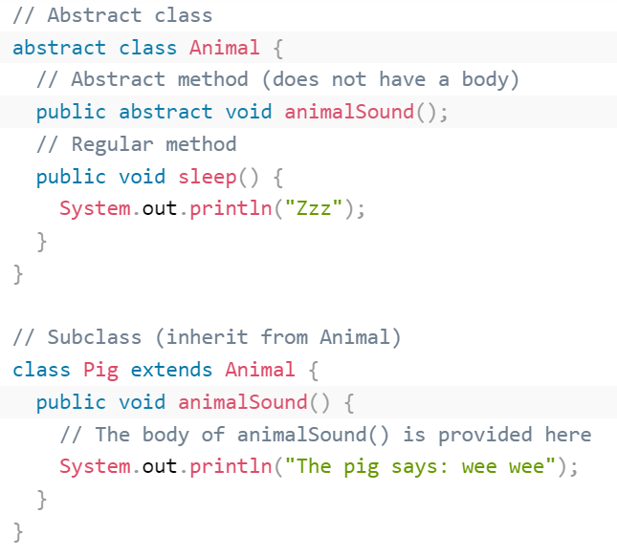
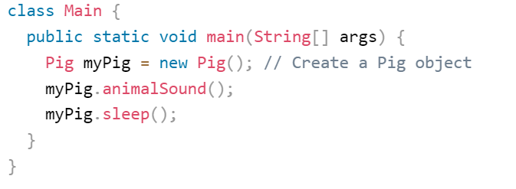

An Abstract Class Example
Output

Slide 40

An Abstract Class Example Output
abstract class Bike{
abstract void run();
}
class Honda4 extends Bike{
void run(){System.out.println("running safely");}
public static void main(String args[]){
Bike obj = new Honda4();
obj.run();
}
}

Slide 41

An Abstract Class Example Output
Shape is the abstract class, and its implementation is provided by the Rectangle and Circle classes.
abstract class Shape{
abstract void draw();
}
//In real scenario, implementation is provided by others i.e. unknown by end user
class Rectangle extends Shape{
void draw(){System.out.println("drawing rectangle");}
}
class Circle1 extends Shape{
void draw(){System.out.println("drawing circle");}
class TestAbstraction1{
public static void main(String args[]){
Shape s=new Circle1();//In a real scenario, object is provided through method, e.g., getShape() method
s.draw();
}
}

Slide 42

An Abstract Class Example
abstract class bank{
abstract int getrateofinterest()
}
class SBI extends bank{
int getrateofinterest()
{return 7;
}
class PNB extends bank{
int getrateofinterest()
{return 8;
}
//creating test class
class testbank{
public static void main(String args[]){
bank b;
b=new SBI();
System.out.println(Rate of interest is"+b.getrateofinterest()+"%");
b=new PNB();
System.out.println(Rate of interest is"+b.getrateofinterest()+"%");
}
}
Output

Slide 43

An Abstract Class Example
abstract class MotorBike {
abstract void brake();
}
class SportsBike extends MotorBike {
// implementation of abstract method
public void brake() {
System.out.println("SportsBike Brake");
}
}
class MountainBike extends MotorBike {
// implementation of abstract method
public void brake() {
System.out.println("MountainBike Brake");
}
}
class Main {
public static void main(String[] args) {
MountainBike m1 = new MountainBike();
m1.brake();
SportsBike s1 = new SportsBike();
s1.brake();
}
}

Slide 44
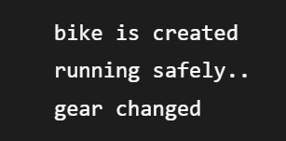
Abstract class having constructor, data member and methods
//example of an abstract class that has abstract and non-abstract methods
abstract class bike{
bike()
{ System.out.println("bike is created");}
abstarct void run();
void changegear()
{System.out.println("gear changed");}
}
//creating child class which inherits abstarct class
class honda extends bike{
void run()
{System.out.println("running safely");}
}
//creating test class which calls abstract and non abstract methods
class testabstract{
public static void main(String args[]){
bike obj=new honda();
obj.run();
obj.changegear();
}
}
Output

Slide 45
Accesses Constructor of Abstract Classes
To access the constructor of an abstract class from the subclass using the super keyword
abstract class Animal {
Animal() {
….
}
}
class Dog extends Animal {
Dog() {
super();
...
}
}

Slide 46
Why And When To Use Abstract Classes and Methods?
To achieve security - hide certain details and only show the important details of an object.

Slide 47
Key Points to Remember
We use the abstract keyword to create abstract classes and methods.
An abstract method doesn't have any implementation (method body).
A class containing abstract methods should also be abstract.
We cannot create objects of an abstract class.
To implement features of an abstract class, we inherit subclasses from it and create objects of the subclass.
A subclass must override all abstract methods of an abstract class. However, if the subclass is declared abstract, it's not mandatory to override abstract methods.
We can access the static attributes and methods of an abstract class using the reference of the abstract class.
For example, Animal.staticMethod();

Slide 48
Interfaces
An interface is a completely "abstract class" that is used to group related methods with empty bodies
To access the interface methods, the interface must be "implemented" by another class with the implements keyword (instead of extends)
interface Animal {
public void animalSound(); // interface method (does not have a body)
public void run(); // interface method (does not have a body)
}

Slide 49

Interfaces
interface Animal {
public void animalSound(); // interface method (does not have a body)
public void sleep(); // interface method (does not have a body)
}
// Pig "implements" the Animal interface
class Pig implements Animal {
public void animalSound() {
// The body of animalSound() is provided here
System.out.println("The pig says: wee wee");
}
public void sleep() {
// The body of sleep() is provided here
System.out.println("Zzz");
}
}
class Main {
public static void main(String[] args) {
Pig myPig = new Pig(); // Create a Pig object
myPig.animalSound();
myPig.sleep();
}
}

Slide 50

Interfaces(examples )
interface Polygon {
void getArea(int length, int breadth);
}
// implement the Polygon interface
class Rectangle implements Polygon {
// implementation of abstract method
public void getArea(int length, int breadth) {
System.out.println("The area of the rectangle is " + (length * breadth));
}
}
class Main {
public static void main(String[] args) {
Rectangle r1 = new Rectangle();
r1.getArea(5, 6);
}
}

Slide 51

Interfaces(examples )
interface Language {
void getName(String name);
}
// class implements interface
class ProgrammingLanguage implements Language {
// implementation of abstract method
public void getName(String name) {
System.out.println("Programming Language: " + name);
}
}
class Main {
public static void main(String[] args) {
ProgrammingLanguage language = new ProgrammingLanguage();
language.getName("Java");
}
}

Slide 52
Interfaces
Like abstract classes, interfaces cannot be used to create objects (in the example above, it is not possible to create an "Animal" object in the MyMainClass)
Interface methods do not have a body - the body is provided by the "implement" class
On implementation of an interface, you must override all of its methods
Interface methods are by default abstract and public
Interface attributes are by default public, static and final
An interface cannot contain a constructor (as it cannot be used to create objects)

Slide 53
Why And When To Use Interfaces?
To achieve security - hide certain details and only show the important details of an object (interface).
Java does not support "multiple inheritance" (a class can only inherit from one superclass). However, it can be achieved with interfaces, because the class can implement multiple interfaces.

Slide 54

Multiple Interfaces
interface FirstInterface {
public void myMethod(); // interface method
}
interface SecondInterface {
public void myOtherMethod(); // interface method
}
class DemoClass implements FirstInterface, SecondInterface {
public void myMethod() {
System.out.println("Some text..");
}
public void myOtherMethod() {
System.out.println("Some other text...");
}
}
class Main {
public static void main(String[] args) {
DemoClass myObj = new DemoClass();
myObj.myMethod();
myObj.myOtherMethod();
}
}

Slide 55
Implementing Multiple Interfaces
interface A {
// members of A
}
interface B {
// members of B
}
class C implements A, B {
// abstract members of A
// abstract members of B
}

Slide 56
Extending an Interface
interface Line {
// members of Line interface
}
// extending interface
interface Polygon extends Line {
// members of Polygon interface
// members of Line interface
}

Slide 57
Extending Multiple Interfaces
interface A {
...
}
interface B {
...
}
interface C extends A, B {
...
}

Slide 58
Interfaces
All the methods inside an interface are implicitly public and all fields are implicitly public static final
interface Language {
// by default public static final
String type = "programming language";
// by default public
void getName();
}

Slide 59
Default methods
add methods with implementation inside an interface. These methods are called default methods.
To declare default methods inside interfaces, we use the default keyword.
public default void getSides() {
// body of getSides()
}

Slide 60
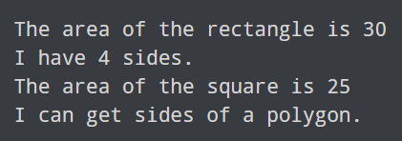
Default methods(Example)
Interface Polygon {
void getArea();
// default method
default void getSides() {
System.out.println("I can get sides of a polygon.");
}
}
// implements the interface
class Rectangle implements Polygon {
public void getArea() {
int length = 6;
int breadth = 5;
int area = length * breadth;
System.out.println("The area of the rectangle is " + area);
}
// overrides the getSides()
public void getSides() {
System.out.println("I have 4 sides.");
}
}
// implements the interface
class Square implements Polygon {
public void getArea() {
int length = 5;
int area = length * length;
System.out.println("The area of the square is " + area);
}
}
class Main {
public static void main(String[] args) {
// create an object of Rectangle
Rectangle r1 = new Rectangle();
r1.getArea();
r1.getSides();
// create an object of Square
Square s1 = new Square();
s1.getArea();
s1.getSides();
}
}

Slide 61
Private and Static Methods in Interface
/ create an interface
interface Polygon {
staticMethod(){..}
}
// access static method
Polygon.staticMethod();

Slide 62

More Example of Interface
class Triangle implements Polygon {
private int a, b, c;
private double s, area;
// initializing sides of a triangle
Triangle(int a, int b, int c) {
this.a = a;
this.b = b;
this.c = c;
s = 0;
}
// calculate the area of a triangle
public void getArea() {
s = (double) (a + b + c)/2;
area = Math.sqrt(s*(s-a)*(s-b)*(s-c));
System.out.println("Area: " + area);
}
}
class Main {
public static void main(String[] args) {
Triangle t1 = new Triangle(2, 3, 4);
// calls the method of the Triangle class
t1.getArea();
// calls the method of Polygon
t1.getPerimeter(2, 3, 4);
}
}
// To use the sqrt function
import java.lang.Math;
interface Polygon {
void getArea();
// calculate the perimeter of a Polygon
default void getPerimeter(int... sides) {
int perimeter = 0;
for (int side: sides) {
perimeter += side;
}
System.out.println("Perimeter: " + perimeter);
}
}

Slide 63
Difference between abstract class and interface
Abstract class | Interface
1) Abstract class can have abstract and non-abstract methods. | Interface can have only abstract methods. Since Java 8, it can have default and static methods also.
2) Abstract class doesn't support multiple inheritance. | Interface supports multiple inheritance.
3) Abstract class can have final, non-final, static and non-static variables. | Interface has only static and final variables.
4) Abstract class can provide the implementation of interface. | Interface can't provide the implementation of abstract class.
5) The abstract keyword is used to declare abstract class. | The interface keyword is used to declare interface.
6) An abstract class can extend another Java class and implement multiple Java interfaces. | An interface can extend another Java interface only.
7) An abstract class can be extended using keyword "extends". | An interface can be implemented using keyword "implements".
8) A Java abstract class can have class members like private, protected, etc. | Members of a Java interface are public by default.
9)Example: public abstract class Shape{ public abstract void draw(); } | Example: public interface Drawable{ void draw(); }

Slide 64
Polymorphism in Java
The word polymorphism means having many forms.
In Java polymorphism is mainly divided into two types:
1. Compile-time Polymorphism
2. Runtime Polymorphism
Type 1: Compile-time polymorphism
It is also known as static polymorphism. This type of polymorphism is achieved by function overloading or operator overloading.
But Java doesn’t support Operator Overloading.
Type 2: Runtime polymorphism
It is also known as Dynamic Method Dispatch. It is a process in which a function call to the overridden method is resolved at Runtime. This type of polymorphism is achieved by Method Overriding.

Slide 65
Method Overloading
Multiple methods with the same name to perform different operations on different parameters.
Overloading is having multiple methods in the same class with the same name, but accept different types of parameters.
For instance:
public double add(double num1, double num2) {
return num1 + num2;
}
public String add(String str1, String str2) {
return str1 + str2;
}
Even though both of these methods are named add, they perform different operations on different parameters.

Slide 66
Method Overloading
When we call a method, the compiler must determine which of the methods to use through a process called binding.
Java binds methods by matching a method’s signature to how it is called.
A method’s signature consists of its name and the data types of its parameters.
The signatures of the two previous methods are:
add(double, double)
add(String, String)
So the java compiler can tell which method to used based on how it was called.
Note, that you cannot have methods with the same name and same data types for parameters EVEN IF THEY HAVE A DIFFERENT return type.

Slide 67
Simple Example of Method Overloading
class OverloadDemo
{
void test() {
System.out.println(“No parameters”);
}
void test(int a) {
System.out.println(“a:”+a);
}
void test(int a, int b){
System.out.println(“a and b:”+a+ “ ”+b);
}
double test(double a){
System.out.println(“double a: “ +a);
return a*a;
}
}
class Overload {
Public static void main(String args[])
{
OverloadDemo ob= newOverloadDemo();
double result;
ob.test();
ob.test(10);
ob.test(10,20);
result= ob.test(123.2);
System.out.println(“Result of ob.test(123.2):” + result);
}
}
No Parameters
a:10
a and b:10 20
Double a: 123.2a: 123.2

Slide 68
Overloading Constructors
Constructors can be overloaded like methods.
The constructor overloading can be defined as the concept of having more than one constructor with different parameters so that every constructor can perform a different task.

Slide 69
Example of Constructor Overloading
Class OverloadCons{
public static void main(String args[]){
Box mybox1= new Box(10,20,15);
Box mybox2 = new Box();
Box mycube= new Box(7);
double vol;
// get volume of first box
vol= mybox1.volume();
System.out.println(“Volume of mybox1 is “ +vol);
//get volume of second box
vol= mybox2.volume();
System.out.println(“Volume of mybox2 is” +vol);
// get volume of cube
vol=mycube.volume()
System.out.println(“Volume of mycube is” +vol);
}
}
Class Box{
double width, height,depth;
Box(double w, double h, double d){
width=w;
height=h;
depth = d;
}
Box(){
width=-1;
height = -1;
depth= -1;
}
Box(double len) {
width=height=depth=len;
}
double volume() {
return width * height * depth;
}
}
3000.0
-1.0
343.0

Slide 70
Using Objects as Parameters
class Test{
int a,b;
Test(int i, int j)
{
a=i;
b=j;
}
// return true if o is equal to the invoking object
boolean equal(Test o) {
if(o.a = = this.a && o.b==this.b) return true;
else return false;
}
}
Class PassOb {
Public static void main (string args[]){
Test ob1= new Test(100, 22);
Test ob2= new Test(100,22);
Test ob3 = new Test(-1, -1);
System.out.println(“ob1 == ob2: “ +ob1.equal(ob2));
System.out.println(“ob1 == ob3:” + ob1.equal(ob3));
}
}
Output-> ob1 == ob2 : true
Output-> ob1 == ob3: false

Slide 71
Problem Statement – Method overloading
Write a class Shapes as circle, square and rectangle.
Find the area of these shapes using constructor overloading and method overloading.

Slide 72
Method Overriding
If subclass (child class)has the same method as declared in the parent class, it is known as method overriding.
Usage
It is used to provide specific implementation of method that
is already provided by its super class.
2. Method overriding is used for runtime polymorphism.
Rule
Method must have same name as in the parent class.
Method must have same parameter as in the parent class.

Slide 73
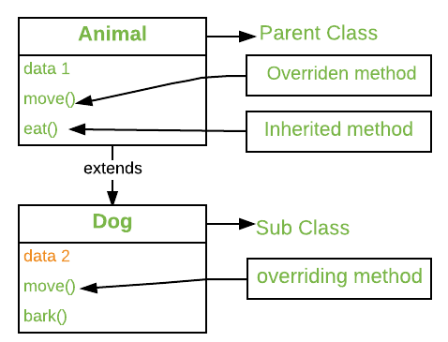
Method Overriding
The version of a method that is executed will be determined by the object that is used to invoke it. If an object of a parent class is used to invoke the method, then the version in the parent class will be executed, but if an object of the subclass is used to invoke the method, then the version in the child class will be executed.

Slide 74
Example of Method Overriding
Class Figure {
double dim1;
double dim2;
Figure(double a, double b) {
dim1 = a;
dim2 = b;
}
double area() {
System.out.println(“Area for Figure is undefined.”);
return 0;
}
}
Class Rectangle extends Figure {
Rectangle(double a, double b) {
super(a,b);
}
//override area for rectangle
double area()
{
System.out.println(“Inside Area for Rectangle.”);
return dim1 * dim2;
}
}
Class Triangle extends Figure {
Triangle(double a, double b) {
super(a, b);
}
double area() {
System.out.println(“Inside area for Triangle.”);
return dim1 * dim2 /2;
}
}
class FindAreas {
public static void main(Sting args[]) {
Figure f= new Figure(10,10);
rectangle r= new Rectangle(9,5);
Triangle t = new Triangle(10, 8);
Figure figref;
figref = r;
System.out.println(“Area is” +figref.area());
figref = t;
System.out.println(“Area is” + figref.area());
figref = f;
System.out.println(“Area is”+ figref.area());
}
}
45
40
0

Slide 75
Problem Statement – Method overriding
Create a parent class Hillstations with the methods location() and famousfor(). Create three subclasses by hill station names e.g. Manali, Shimla etc. Subclasses extend the superclass and override methods location() and famousfor(). Call the methods location() and famousfor() by the Parent class, i.e. Hillstations class. It should refer to the base class object and the subclass method overrides the superclass method, base class method is invoked at runtime.

Slide 76
Key learnings
constructor overloading is somewhat similar to method overloading
constructor overloading is used for different ways of initializing an object
method overloading is used when there are different definitions of a method based on different parameters.
For Method overriding, both the superclass and the subclass must have the same method name, the same return type and the same parameter list.
We cannot override the method declared as final and static .
We should always override abstract methods of the superclass

Slide 77
Thank You!!

